Slide 1
SIGN LANGUAGE RECOGNITION
Submitted BY:
Anitta Shaijy Athappilly
S3 mca

Slide 2
Objectives
The objective of the project is defined as what we plan to achieve at the end of our project. Our project goal is to create a sign dectector that detect various hand gestures using finger spelling.
The objectives can be explained as:
IMAGE CAPTURING
IMAGE PROCESSING
FEATURE EXTRACTION

Slide 3
Description
Communication is very crucial to human beings, as it enables us to express ourselves. We communicate through speech, gestures, body language, reading, writing or through visual aids, speech being one of the most commonly used among them. Sign languages are an extremely important communication tool for many deaf and hard-of-hearing people. This project aims for building a recognition system for deaf and dumb people.
In this sign language recognition project, we create a sign detector, which detects alphabets from A to Z that can very easily be extended to cover a vast multitude of other signs and hand gestures.

Slide 4
PREREQUISITES
The prerequisites software & libraries for the sign language project are:
Python
IDE (Jupyter)
Numpy
cv2 (openCV)
Keras
Tensorflow

Slide 5
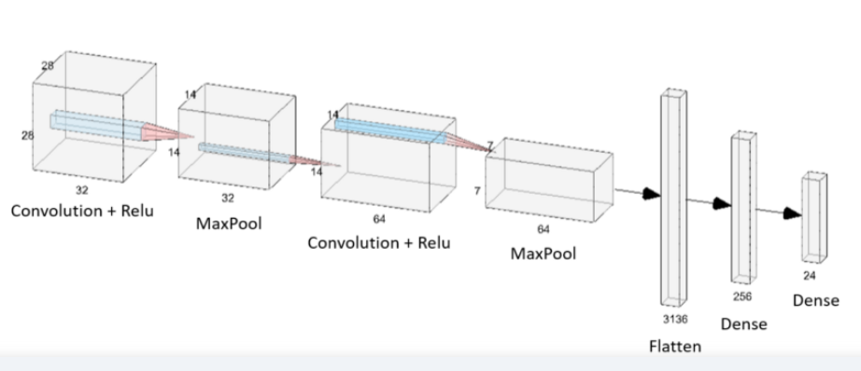
AlGORITHMS AND DATASET
We use Convolutional Neural Network(CNN) algorithm in our project.This is because:
CNN’s are very effective in reducing the number of parameters without losing on the quality of models. Images have high dimensionality (as each pixel is considered as a feature) which suits the above-described abilities of CNNs.
CNN retains the 2D spatial form of images.
All the layers of a CNN have multiple convolutional filters working and scanning the complete feature matrix and carry out the dimensionality reduction. This enables CNN to be a very apt and fit network for image classifications and processing.

Slide 6
INPUT AND OUTPUT MODULES
INPUT MODULE
It is defined as the inputs that we given to our project to generate the result. The input modules in our sign language recognition project are:
Capturing the image
Involves capturing the images of our hand gestures on real time using a web camera.
Detect the image
The captured images are detected to identify the hand gesture .

Slide 7
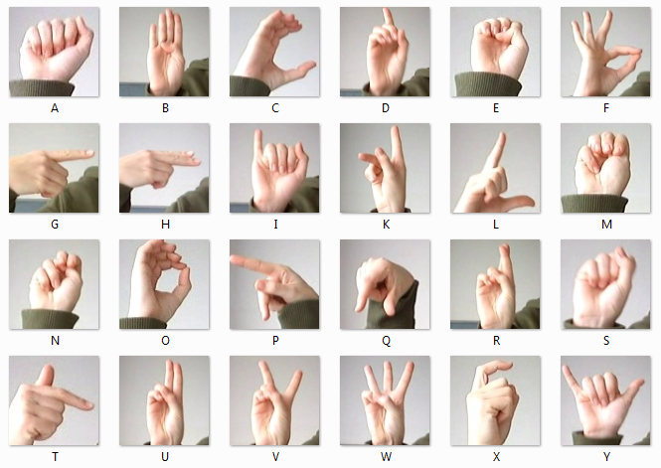
DATASET
We use the MNIST dataset format as the data set for our project. Each training and test case represents a label (0-25) as a one-to-one apt for each alphabetic letter A-Z . The training data (27,455 cases) and test data (7172 cases).

Slide 8
MODULE
OUTPUT MODULE
The output module is defined as the generating the desired result as the output.
Predict the gesture
The captured images are analyzed to detect the hand gesture and the corresponding name of the gesture is displayed as output.

Slide 9
CODE DESCRIPTION
from tkinter import *
import ctypes,os
from tkinter.tix import *
from PIL import ImageTk, Image
import tkinter.messagebox as tkMessageBox
from tkinter.filedialog import askopenfilename
home = Tk()
img = Image.open("images/home.png")
img = ImageTk.PhotoImage(img)
panel = Label(home, image=img)
panel.pack(side="top", fill="both", expand="yes")
user32 = ctypes.windll.user32
user32.SetProcessDPIAware()
[w, h] = [user32.GetSystemMetrics(0), user32.GetSystemMetrics(1)]
lt = [w, h]
a = str(lt[0]//2-610)
b= str(lt[1]//2-383)

Slide 10
MAIN
home.title("Sign2Text")
home.geometry("1243x738+"+a+"+"+b)
home.resizable(0,0)
def web():
import app
photo = Image.open("images/button.png")
img2 = ImageTk.PhotoImage(photo)
Button(home, highlightthickness = 0, bd = 0,activebackground="#fbfdff", image = img2,command=web).place(x=40,y=530)
home.mainloop()

Slide 11
UI DESIGN & IMPLEMENTATION DETAILS
The UI design of the sign of the sign language recognition project, we create a sign dectector that can capture the images, detect the images and display the predicted image on the screen. We create a camera frame for this purpose,which calculates the values and can detect the gestures.
The UI of the project can be implemented with the help of tkinter in which we can create a design for our project.

Slide 12
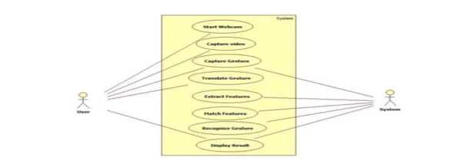
USE CASE OR PROCESS DIAGRAMS
USE CASE DIAGRAM

Slide 13
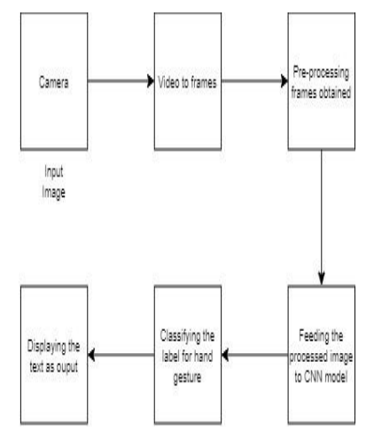
PROCESS DIAGRAM

Slide 14
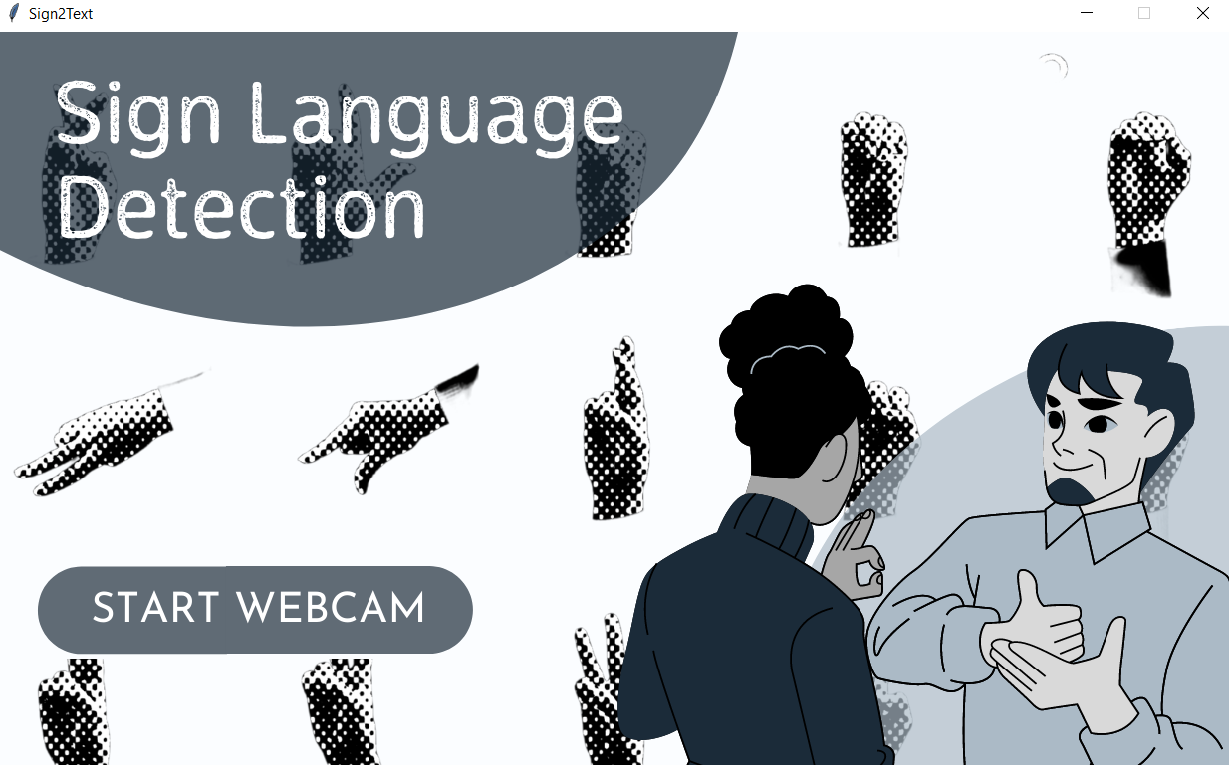
SCREENSHOT

Slide 15
FUTURE SCOPE
In future work, proposed system can be developed and implemented using other technologies. Image Processing part should be improved so that system would be able to communicate in both directions i.e.it should be capable of converting normal language to sign language and vice versa. We will try to recognize signs which include motion. Moreover we will focus on converting the sequence of gestures into text i.e. word and sentences and then converting it into the speech which can be heard.

